Slide 1
Avocado: what is the expected price and consumption of avocado in 2022?
Mireille P. Feudjio T.
Springboard School of Data

Slide 2
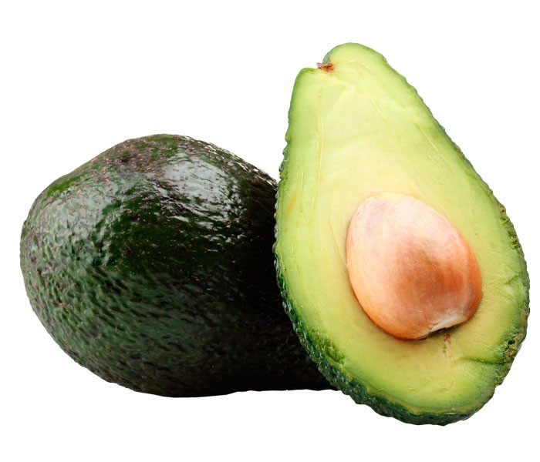
Outline
Context and Problem statement
Exploratory data analysis
Forecasting methodology
Results
Conclusion

Slide 3
Context and problem statement
Avocado for diet, health, nutrition, and food.
Avocado is rich in B vitamins, vitamin E, vitamin K , folate.
U.S. consumption of avocados has generally trended upward since 1970.
2.21 pounds per capita in 2000 to 7.81 pounds per capita in 2019 (Statista, 2020).
U.S. produced 206,610 tons (NASS, 2020).
Company based in the region of New York.
what are the expected avocado prices and quantities to be sold next year that can allow the Company to sign a contract with new producers and increase the price of avocado by 2%?

Slide 4
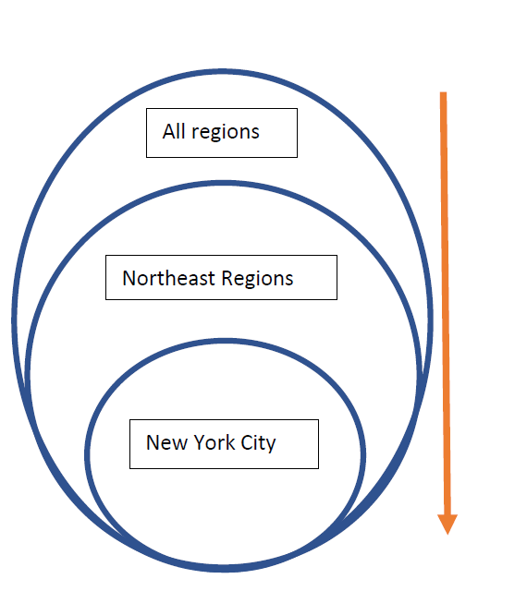
Data acquisition and wrangling (1)
Exploratory data analysis (1)
Dataset shape 41045 rows and 13 columns.
Data wrangling:
renaming of incorrect string;
indexing date and convert to datetime;
checking for duplicate, missing value and data type.
Conceptual framework for EDA

Slide 5
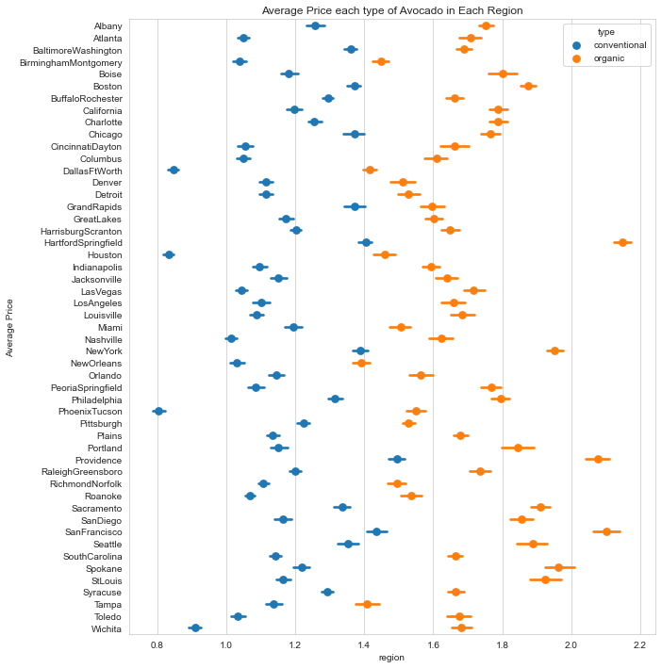

Exploratory data analysis (1)
Price behavior of avocados in all regions

Slide 6
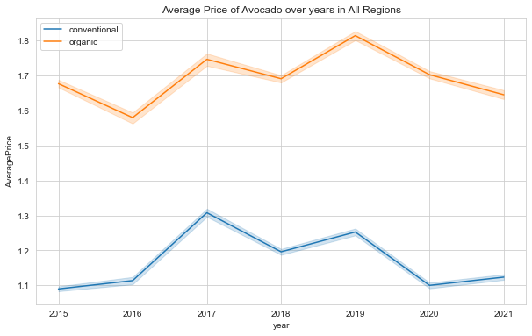
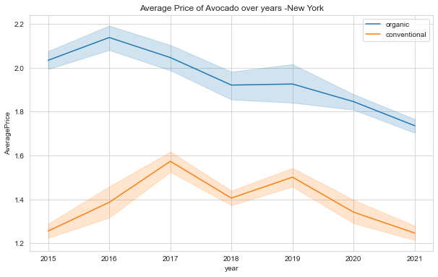
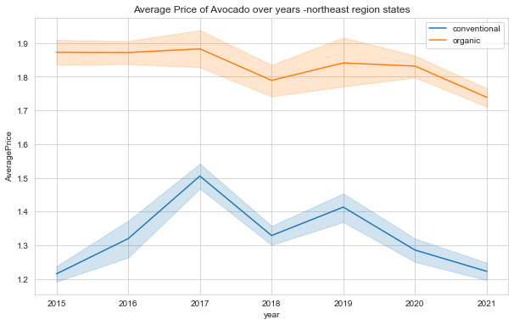

Exploratory data analysis (2)
Price trend of avocados since 2015
Notes:
# northeast region states(#Maine, New Hampshire, Vermont, Massachusetts, Rhode Island, Connecticut, New York, New Jersey, and Pennsylvania)

Slide 7
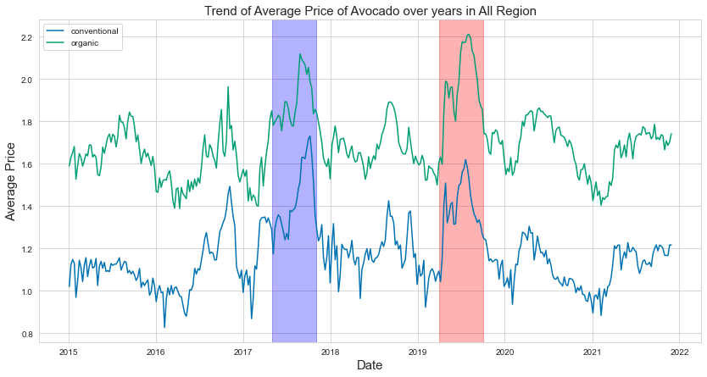
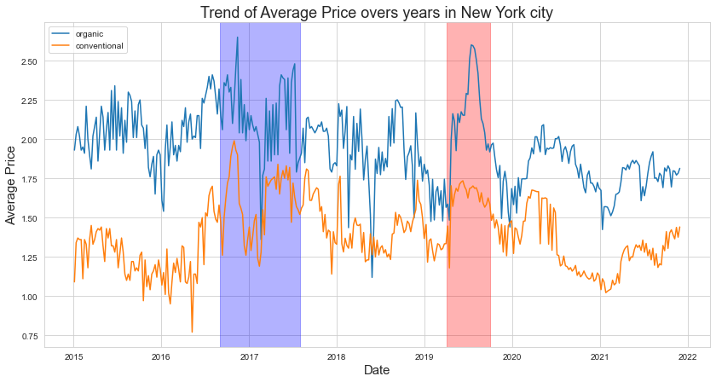
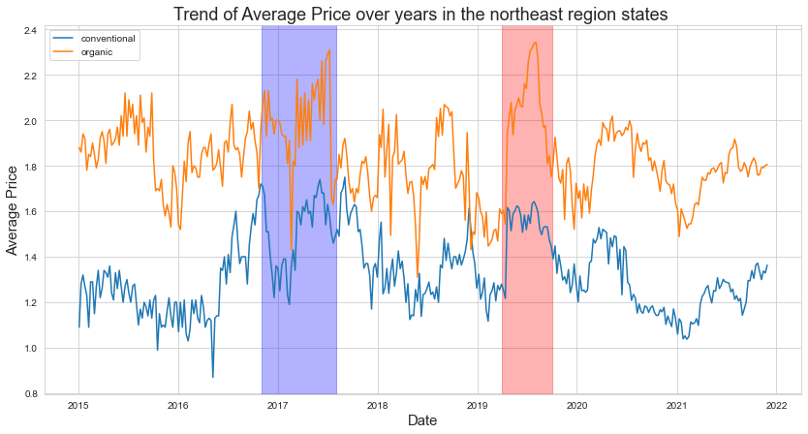
Exploratory data analysis (2)
Weekly trend of avocado prices between years
Notes:
kkkkkkkkkkkkkkkkkkkkkkkk

Slide 8
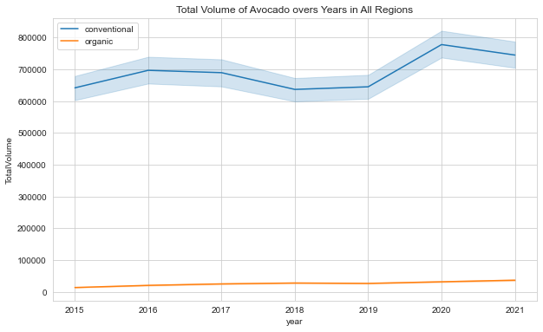
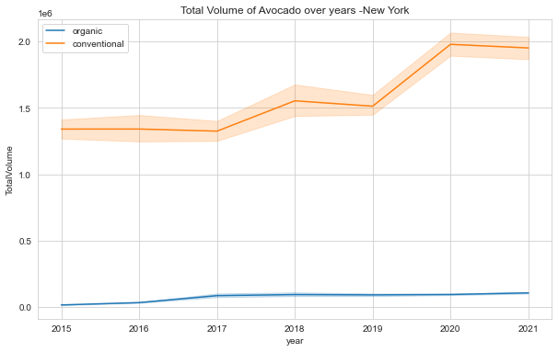
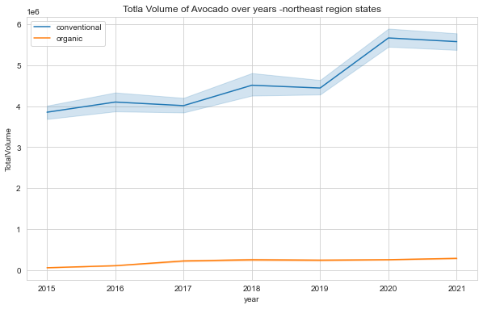



Exploratory data analysis (3)
Trend of avocados sold since 2015

Slide 9
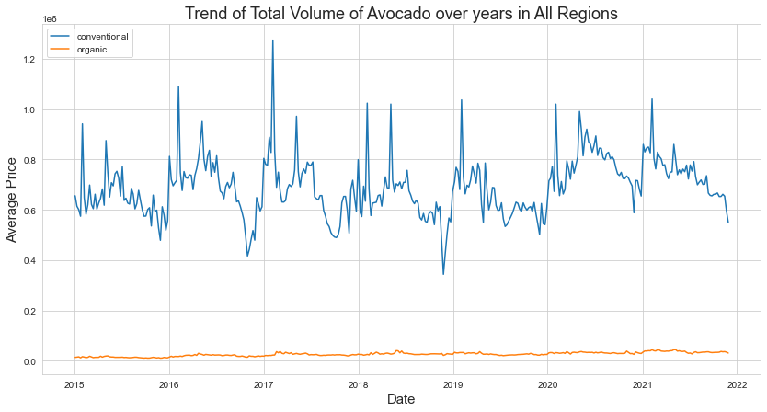
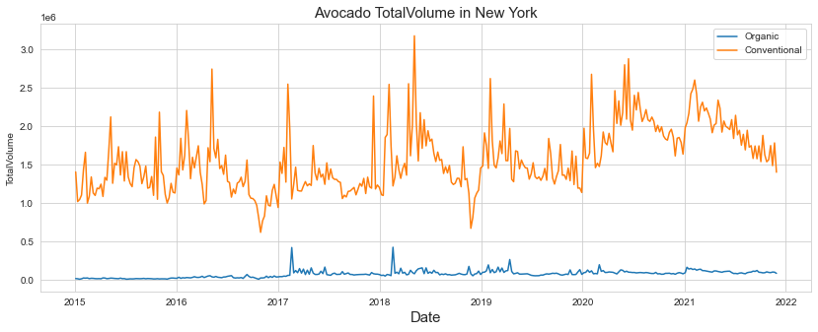
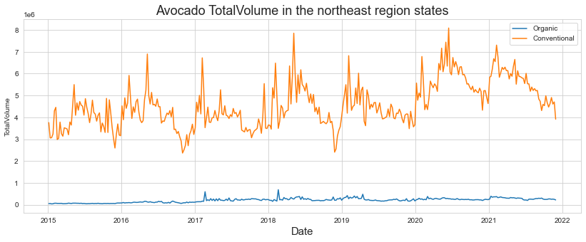
Exploratory data analysis (4)
weekly trend of avocado sold (volume) between years

Slide 10
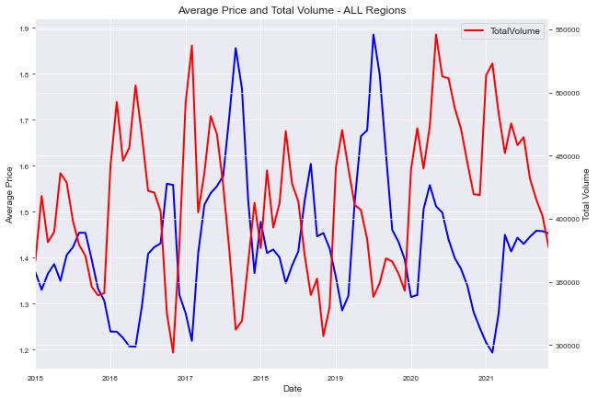
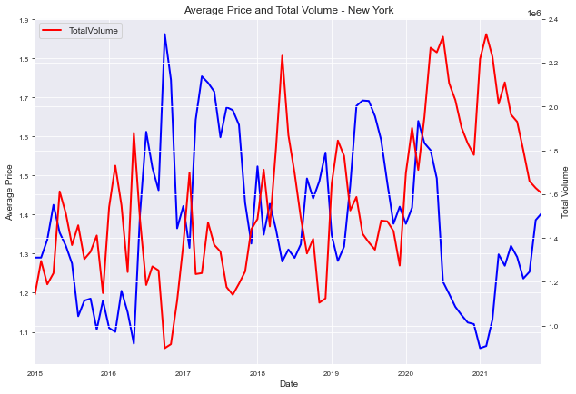
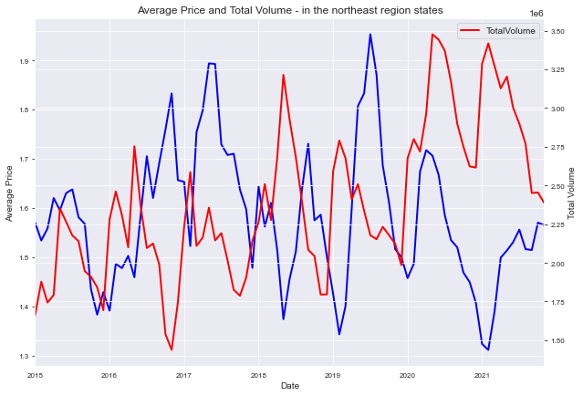
Exploratory data analysis (5)
Trend of prices and volume of avocado over years

Slide 11
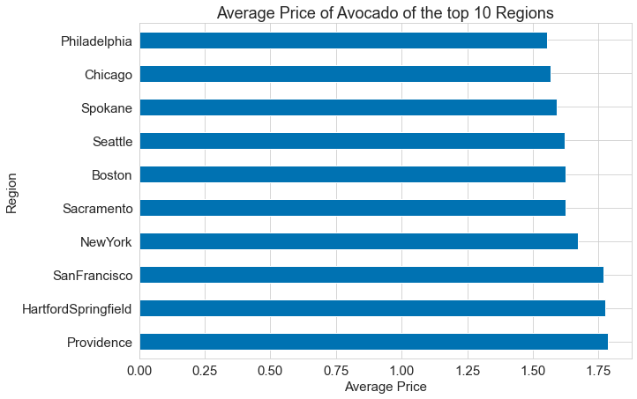
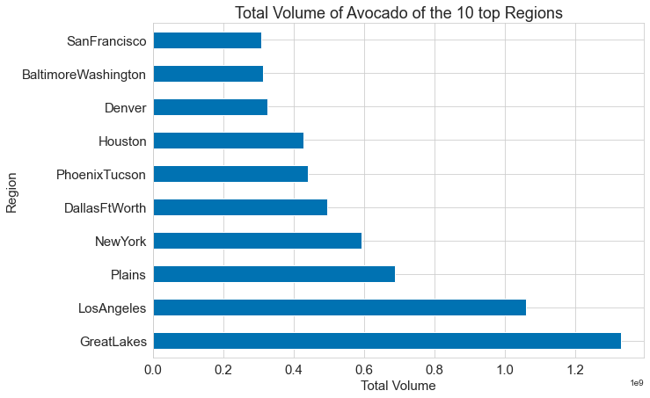
Exploratory data analysis (6)
Top 10 regions with high price and high quantities sold of avocados (conventional and organic) since 2015?

Slide 12




Exploratory data analysis (6)
Type of avocado (organic and conventional) impact the price and the consumption
Table. Summary statistic of Avocado prices and volume in New York
 | conventional Avocado |  | Organic Avocado
 | Average Price | Total Volume | Average Price | Total Volume
count | 361.000 | 361.000 | 361.000 | 361.000
mean | 1.389 | 1566999.169 | 1.952 | 75484.313
std | 0.213 | 414175.263 | 0.242 | 47249.091
min | 0.770 | 618279.770 | 1.119 | 8442.790
25% | 1.230 | 1255552.680 | 1.798 | 40280.960
50% | 1.360 | 1481997.420 | 1.931 | 75479.880
75% | 1.540 | 1838475.070 | 2.110 | 97048.630
max | 1.990 | 3172572.870 | 2.650 | 424186.840

Slide 13
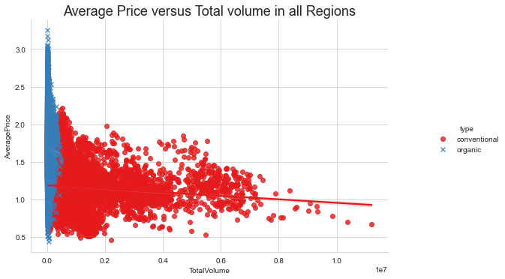
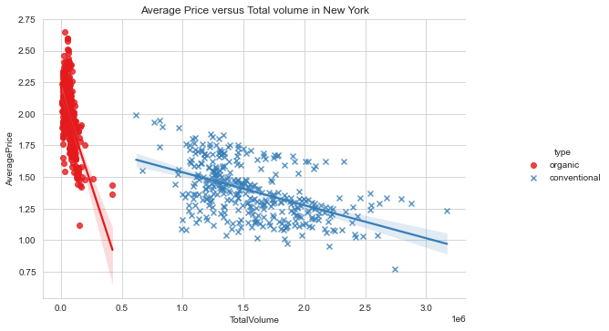
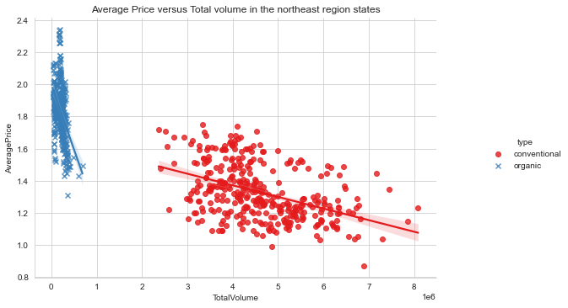
Exploratory data analysis (7)
Relation between the average price, total volume, and avocados type
Notes:
the correlation between price and total volume is -0.31 in all regions, it is -0.44 in Northeast regions and 0,58 in New York. We realized that the correction becomes strong when moving from upper scale to local scale.

Slide 14
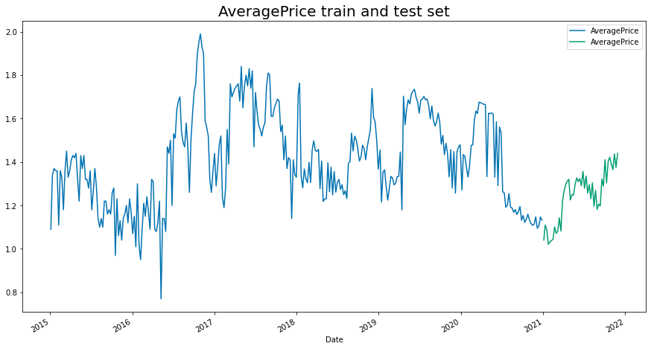
Forecasting methodology (1)
1. Check the stationarity of the time series and define the order of the differencing (d)
Augmented Dickey-Fuller Test (ADF test) and
Kwiatkowski–Phillips–Schmidt–Shin tests (KPSS test) .
2. Get the train and test set

Slide 15
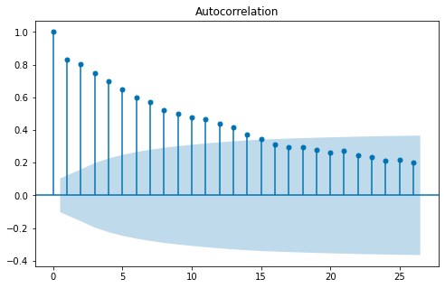
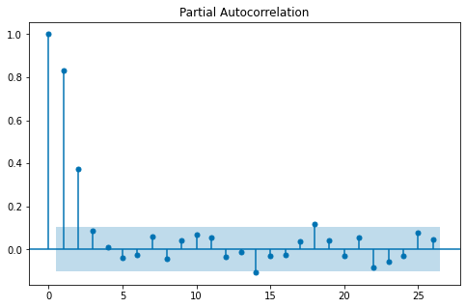
Forecasting methodology (2)
3. identification of AR and MA orders
AR term (p) with partial autocorrelation function(pacf)
MA term (q) with autocorrelation function (acf)
From the plot of ACF and PACF above, it suggested that model is an AR(2) , with p =2 and q = 0
Evaluate different p, d, and q values - select best model according to AIC and BIC
Explored the seasonal with auto_arima function to identify the P,Q,D

Slide 16
Results
Table. New York conventional avocado price models descriptions
Model name | p,d,q non seasonal part | P,D,Q seasonal part | Used of exogenous variable or not | Name of results metric
results_1 | 3,0,1 | - |  | monthly_model_sarimax
results_2 | 1,0,1 | - |  | weekly_model_sarimax
results_3 | 1,0,1 | - |  | weekly_model_arima
results_4 | 8,0,1 | - |  | monthly_model_arima
results_s | 3,0,0 | 0,0,0,52 |  | weekly_model_saisonal
results_s2 | 1,0,0 | 0,0,1,52 |  | monthly_model_saisonal
results_ex | 1,0,1 | 0,0,1,52 | with volume as exogenous | weekly_model_exog
results_ex2 | 1,0,1 | 0,0,0,52 | with volume as exogenous | monthly_model_exog

Slide 17
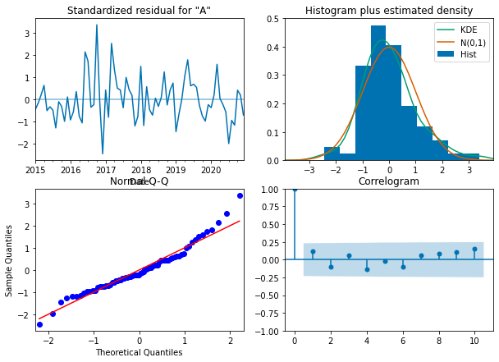
Results (1)
case: conventional avocado price
Model specification (1,0,0,0,0,1),52
(p,d,q,P,D,Q)s

Slide 18
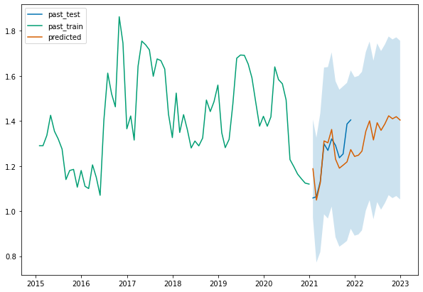
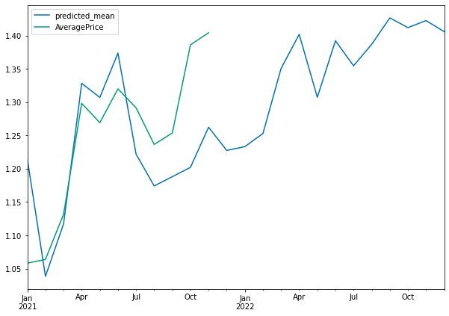
case: conventional avocado price

Slide 19
Conclusion
clear distinction between organic and conventional avocados;
the price of the organic avocado is higher than that of the conventional avocado;
the total volume of organic avocados sold is less than that of conventional avocados;
New York is among the top 5 regions with high price (and high volume) in organic and conventional avocado (occupied 4th or the 5th rang);
when total volume increases, price decreases and vice versa.

Slide 20
Conclusion
8 models have been developed for each type of avocado (conventional price, conventional volume, organic price, organic volume).
Our models did good.
The predicted prices of avocados (conventional and organic) are close to real values.
The average of the difference between this value (pred – actual) MAE is 0.063

Slide 21
Conclusion
Before covid 19, the price and volume of avocado was constantly increasing.
The marketing of avocado was affected between 2019 and 2021.
With time series analysis, this had a considerable impact on forecasting the future value of 2022.
If considering that everything is back to normal (less impact of covid 19), we can suggest to the company to revise the prices of avocado considering the local trend, and the values of the upper limit of the price.

Slide 22
THANK You

